Slide 1
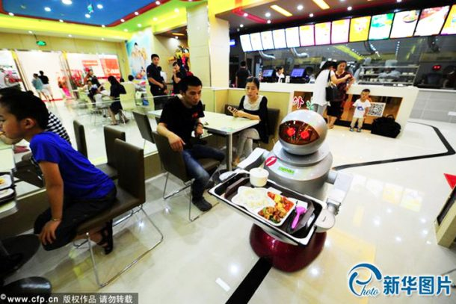
Smart Waiter Robot System
Abdullah Rayyan
Ali Tammam
Supervisor: Dr. Mai Abuseir

Slide 2
Outline
01
Introduction
02
Problem Specification
03
Goals
04
System Overview
05
Hardware Design
06
Line Follower Concept
07
Arduino Code FlowChart
08
Future Work

Slide 3
Introduction
In the smart waiter system, the customer will browse the food category on the tablet and then send the order to kitchen, the tablet already exist on each table.
The chef will prepare the order for each table then put the order on the robot and click on complete button to let robot start moving to that table and return to kitchen.

Slide 4
Problem Specification
The customers face a lot of problems due to congestion at peak hours.
When waiters are unavailable.
Manual order processing will make a mess .
Reducing communication between people in times of epidemics like Covid-19.
Workers being inefficient.

Slide 5
Goals
Increased the ability to apply autonomy from traditional robots to the application of specific robots.
An automated staff will attract a lot of customers.
The value of the work hour is likely to rise.
Reduce the mess in congestion at peak hours.

Slide 6
System Overview
Now we will track the process from ordering food by customer until receiving his order.
This process is done by combination of software and hardware.
The software includes Android program that is installed on two tablets (Customer, Chef) and Arduino program.
The hardware will be explained later.

Slide 7
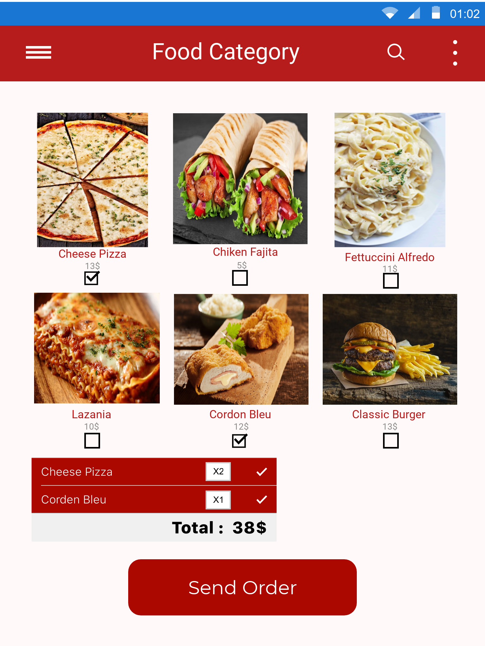
Customer Tablet

Slide 8
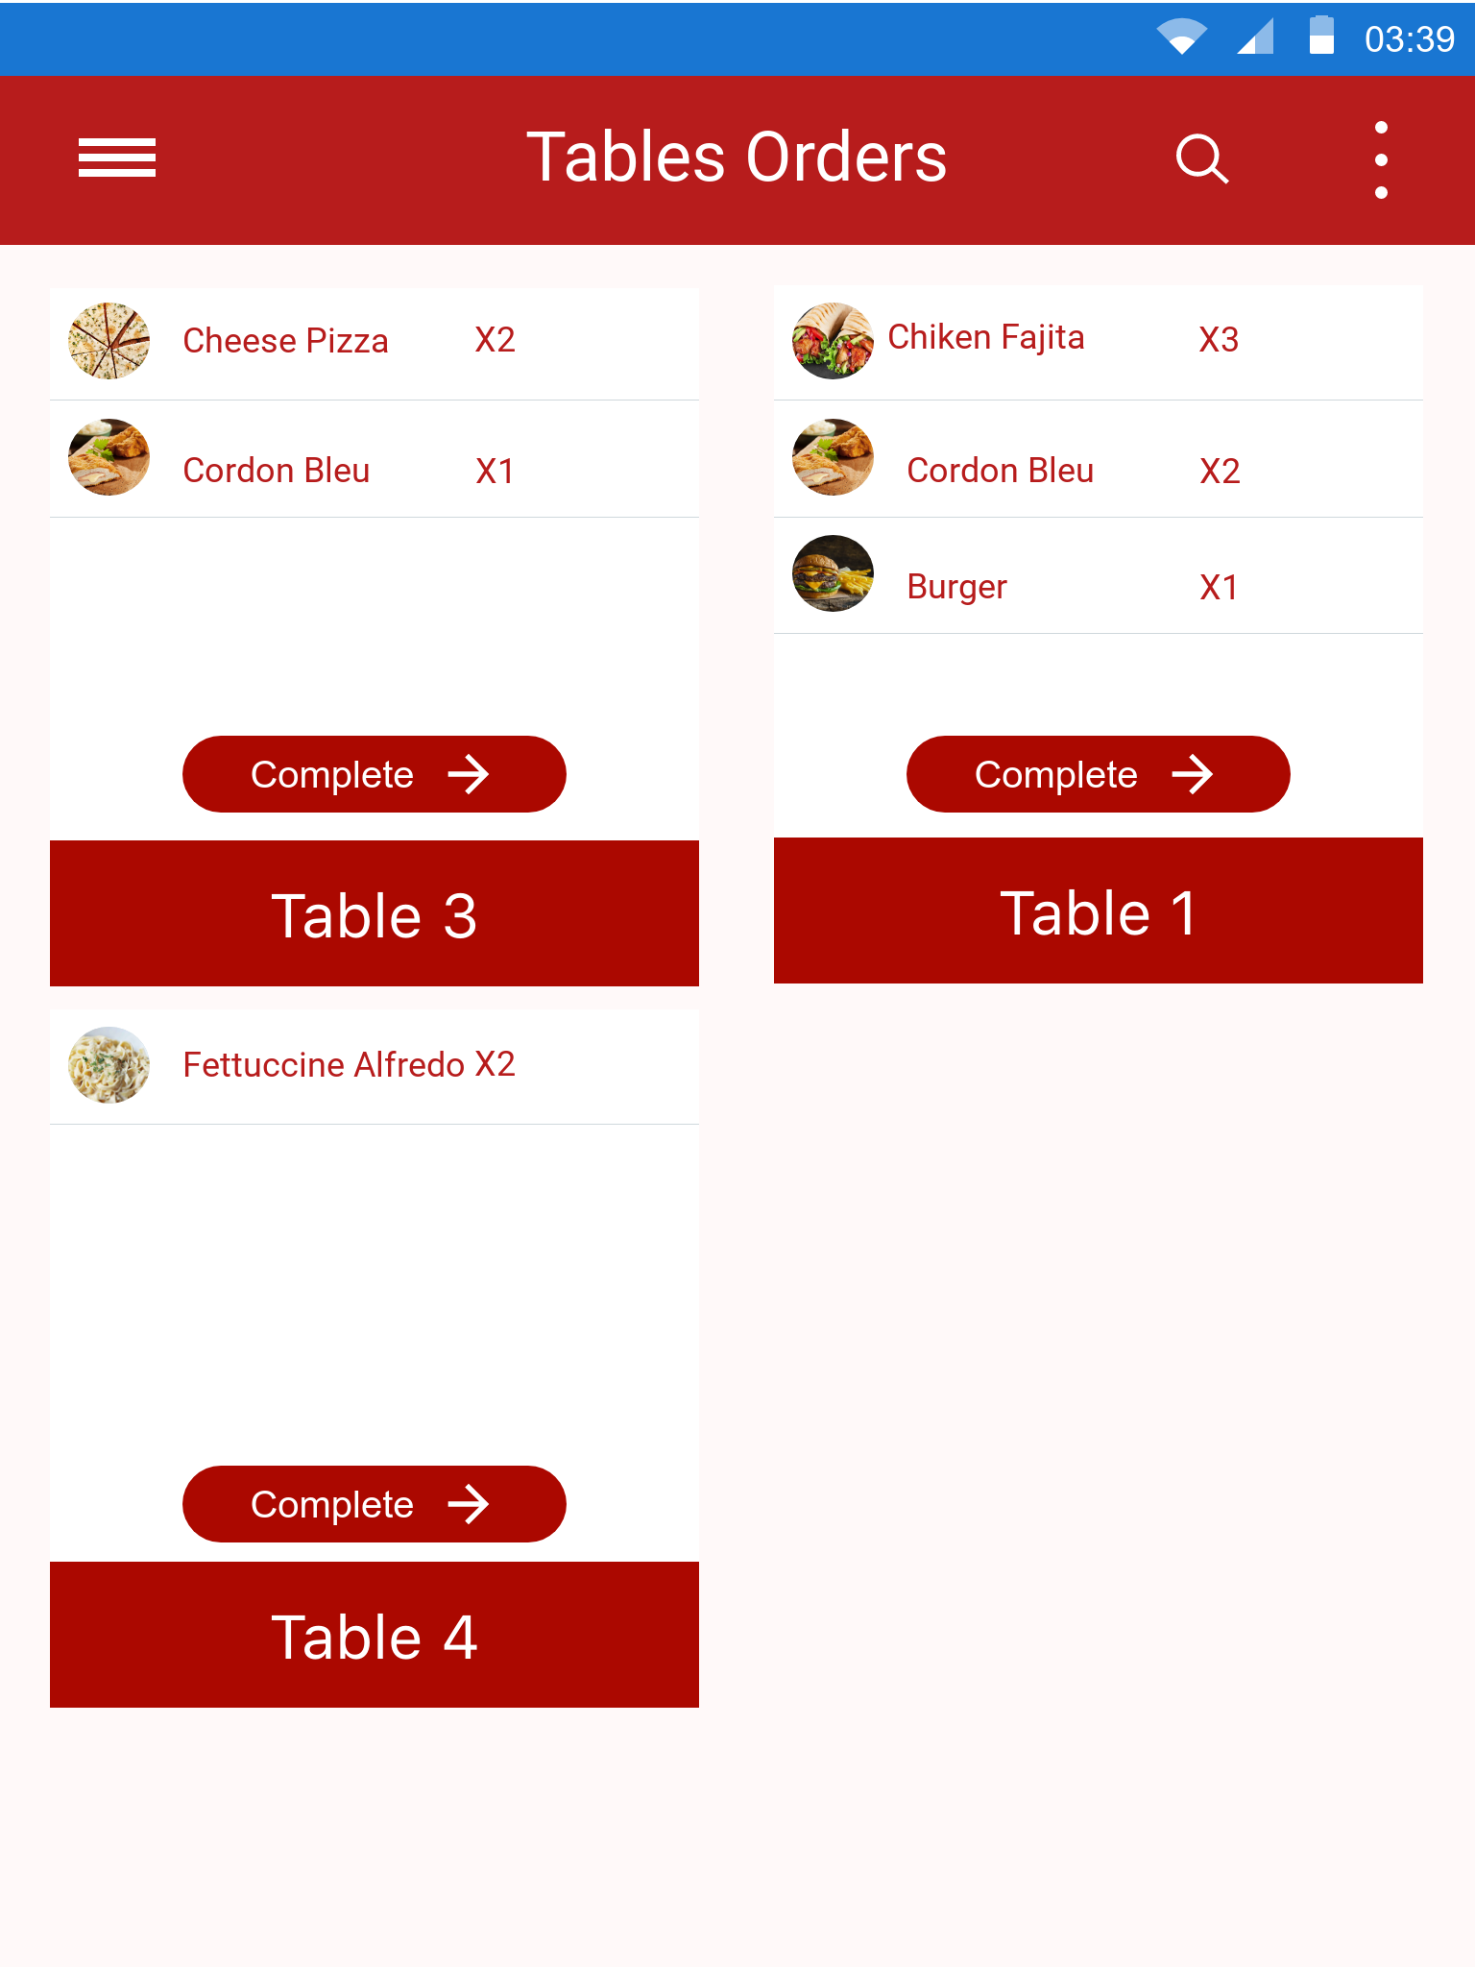
Chef Tablet

Slide 9
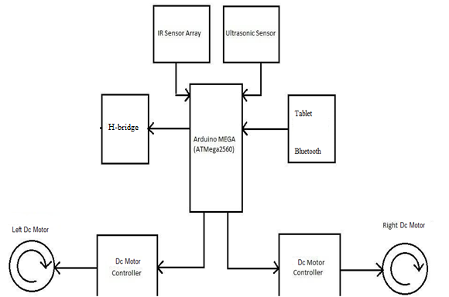
Hardware Design

Slide 10
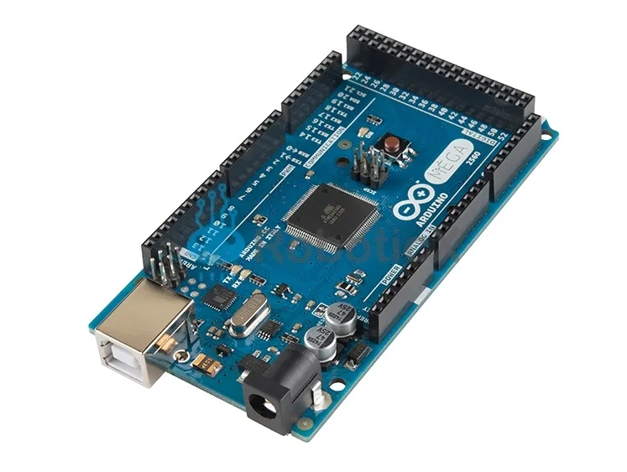
Arduino Mega

Slide 11
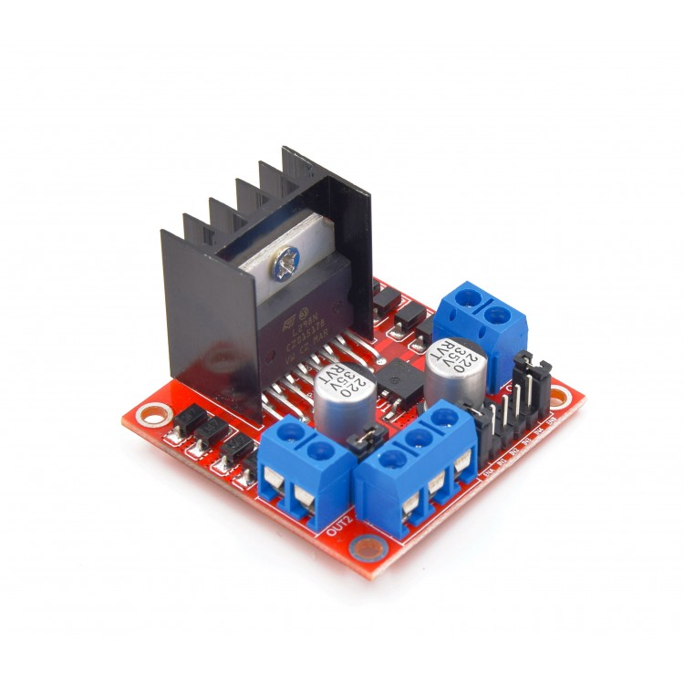
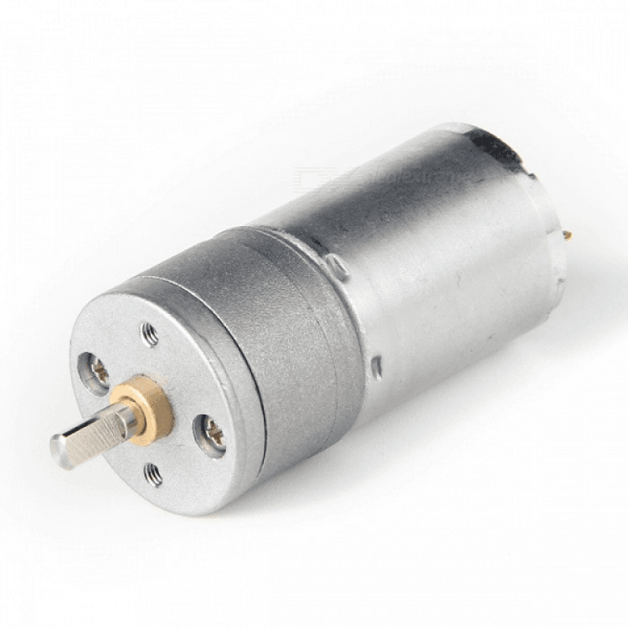
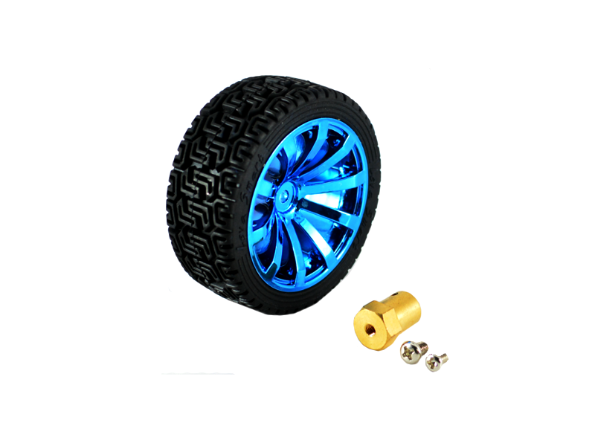
H-Bridge & Motors

Slide 12
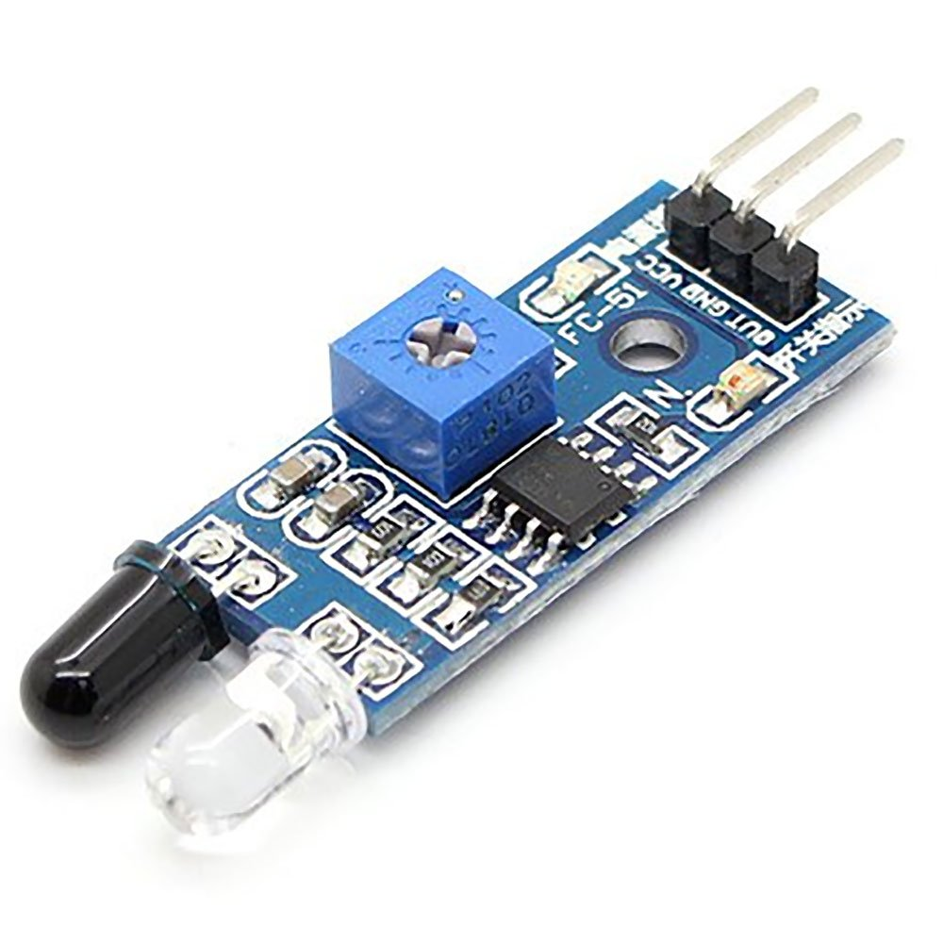
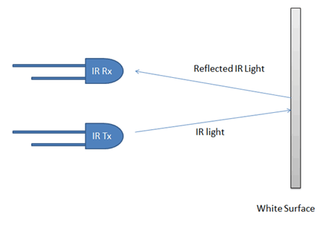
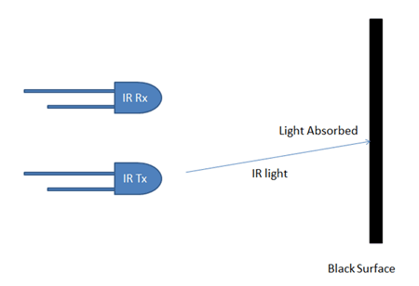
IR Sensor

Slide 13
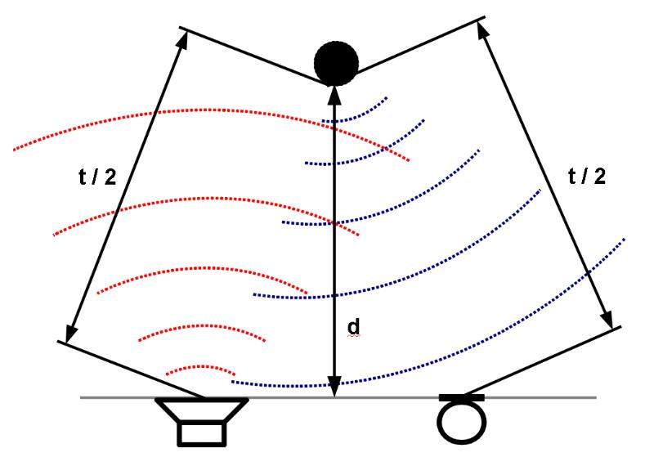
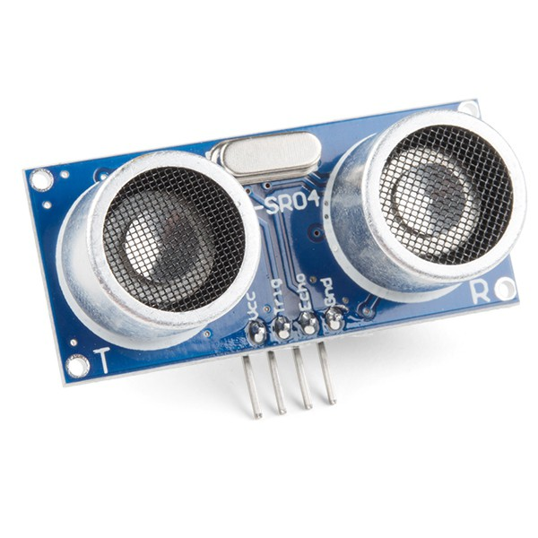
Ultrasonic Sensor

Slide 14
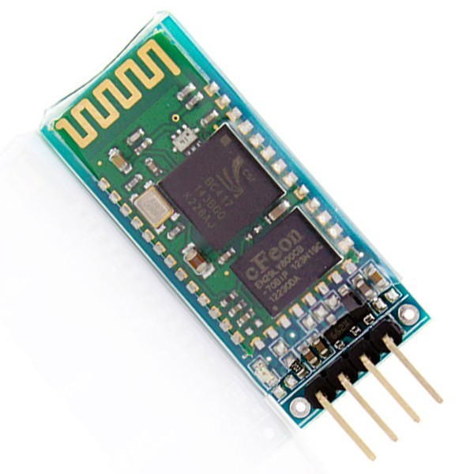
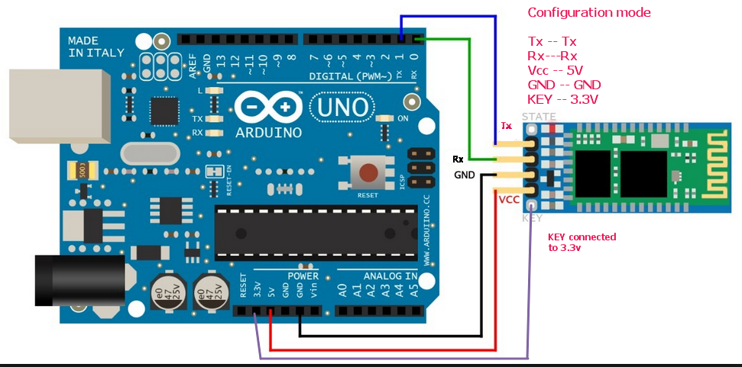
Bluetooth

Slide 15
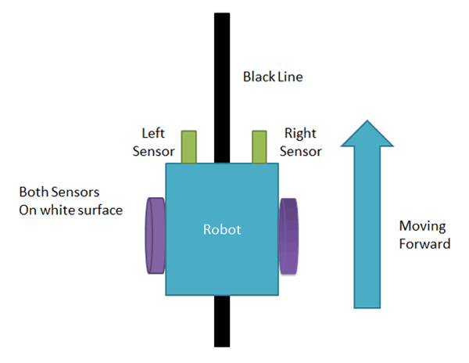
Line Follower Concept

Slide 16
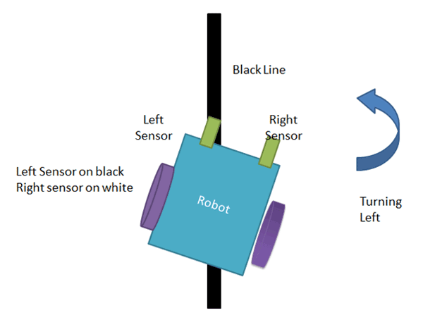
Line Follower Concept

Slide 17
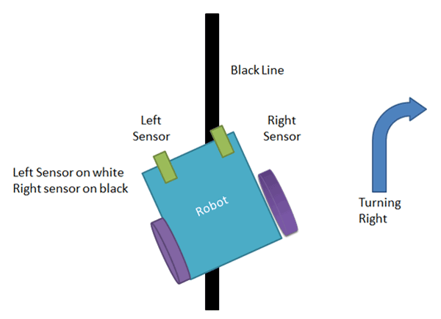
Line Follower Concept

Slide 18
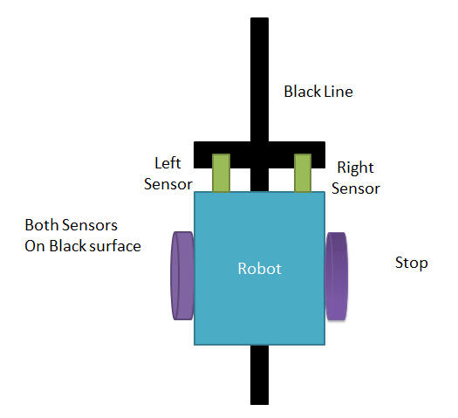
Line Follower Concept

Slide 19
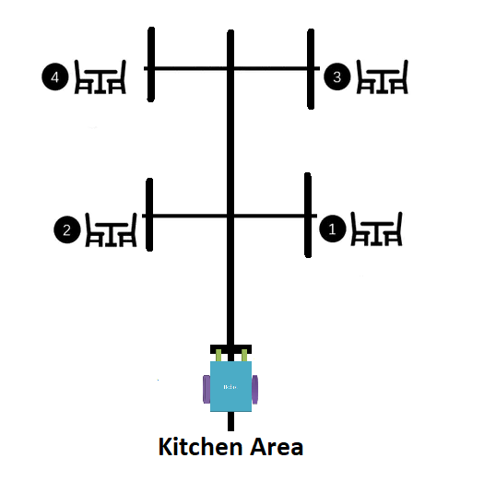
Line Follower Concept

Slide 20
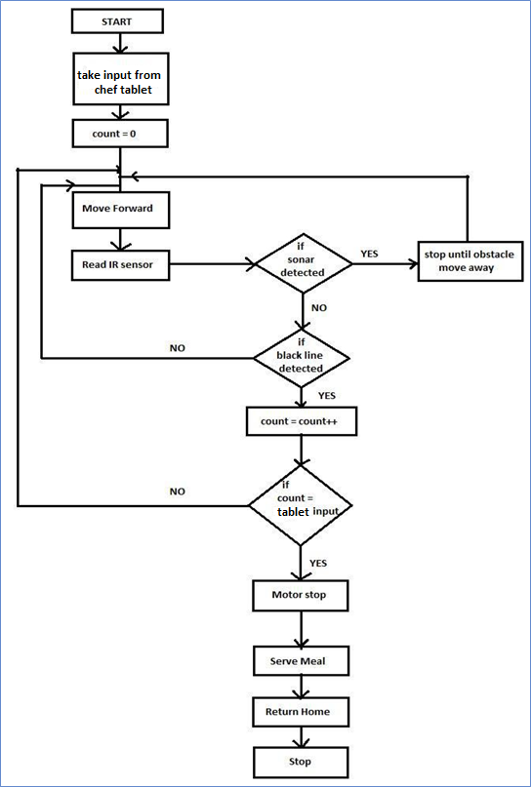
Arduino Code Flowchart

Slide 21
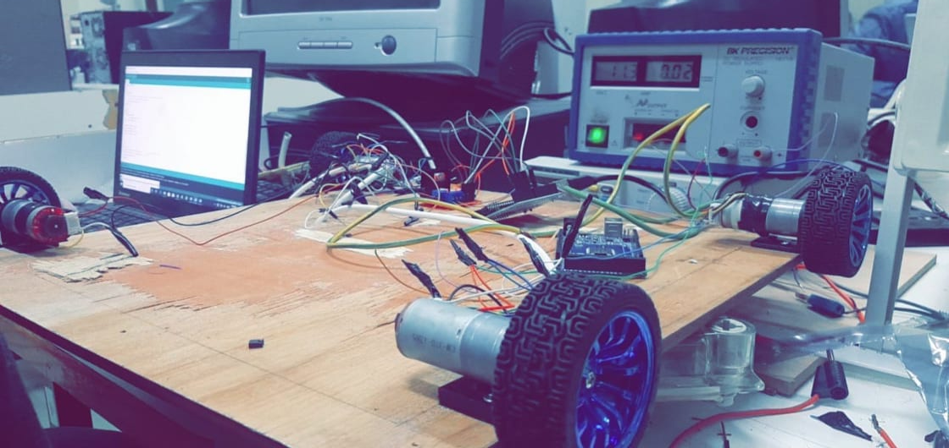
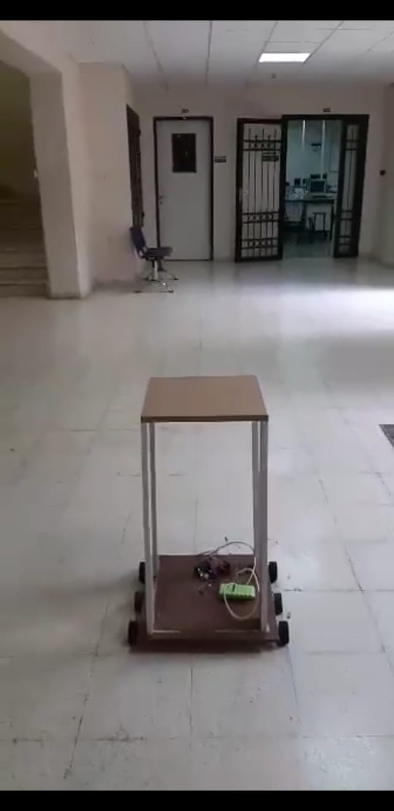

Slide 22
Future Work
Communicate with people
Robot Deliver multiple orders at same time.
Make customer pay his bill with visa by the robot.

Slide 23
Thank You
Thanks for coming today

